Slide 1
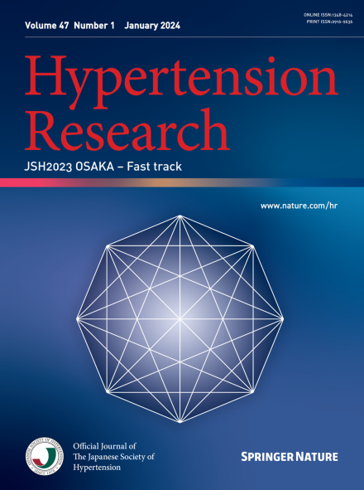
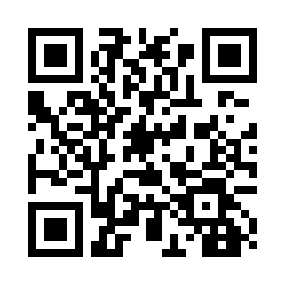
JSH2024 Fukuoka Call for Abstracts!
-JSH International Session-
Open NOW
JSH International Session abstract submission: April 1 – June 10, 2024 (JST)
You can present either onsite or online.
Apply for JSH International Best Presenter Award.
The presentation selected for the Award Session will have the registration fee waived.
The recipients of the Grand Prize and Excellence Award will be limited to on-site presenters only.
Hypertension Research Fast track: April 1 – August 16, 2024 (JST)
You will have a chance to publish your full paper in Hypertension Research!! (IF2022 5.4)
If received by the end of June, the team will perform a “Rapid peer review process” and publish them online on Hypertension Research, on the same day as the presentation at JSH 2024 Fukuoka – JSH International Session.
JSH2024 Fukuoka Abstract Submission
https://www.46jsh2024.org/cfp-en.html
Don’t miss out!
Abstract Submission Deadline:
June 10, 2024 JST.

